Slide 1



Cloud Native Applications
Introducing Spring Boot
Notes:
Resting slide on screen before you begin presenting.

Slide 2
Spring Boot Overview
Takes an opinionated view of building production-ready Spring applications
Spring Boot favors convention over configuration and is designed to get you up and running as quickly as possible
Notes:
Provide radically faster and widely accessible “getting started” experience for all Spring development
Opinionated out of the box, but get out of the way as quickly as possible
Provide a range of non-functional features (embedded servers, metrics, health checks, externalized config)

Slide 3
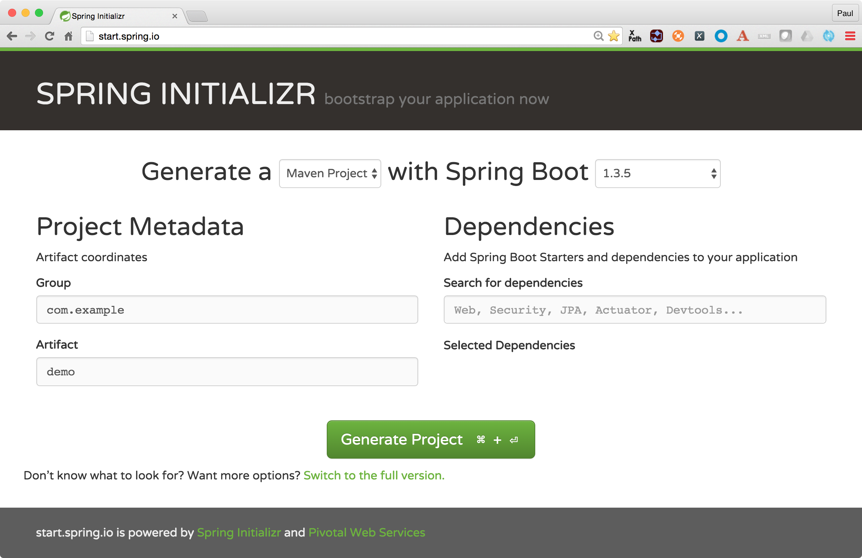
Spring Initializer
Provide a wizard for creating a starter project
Notes:
Install Spring in your Java App simply by including spring-boot-*.jar in your class path, e.g. using Maven or Gradle. For example: ‘spring-boot-starter-parent’ artifact in Maven

Slide 4
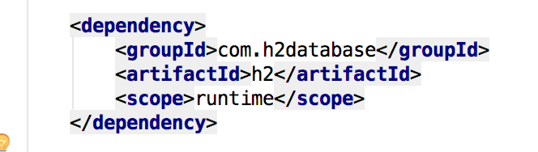

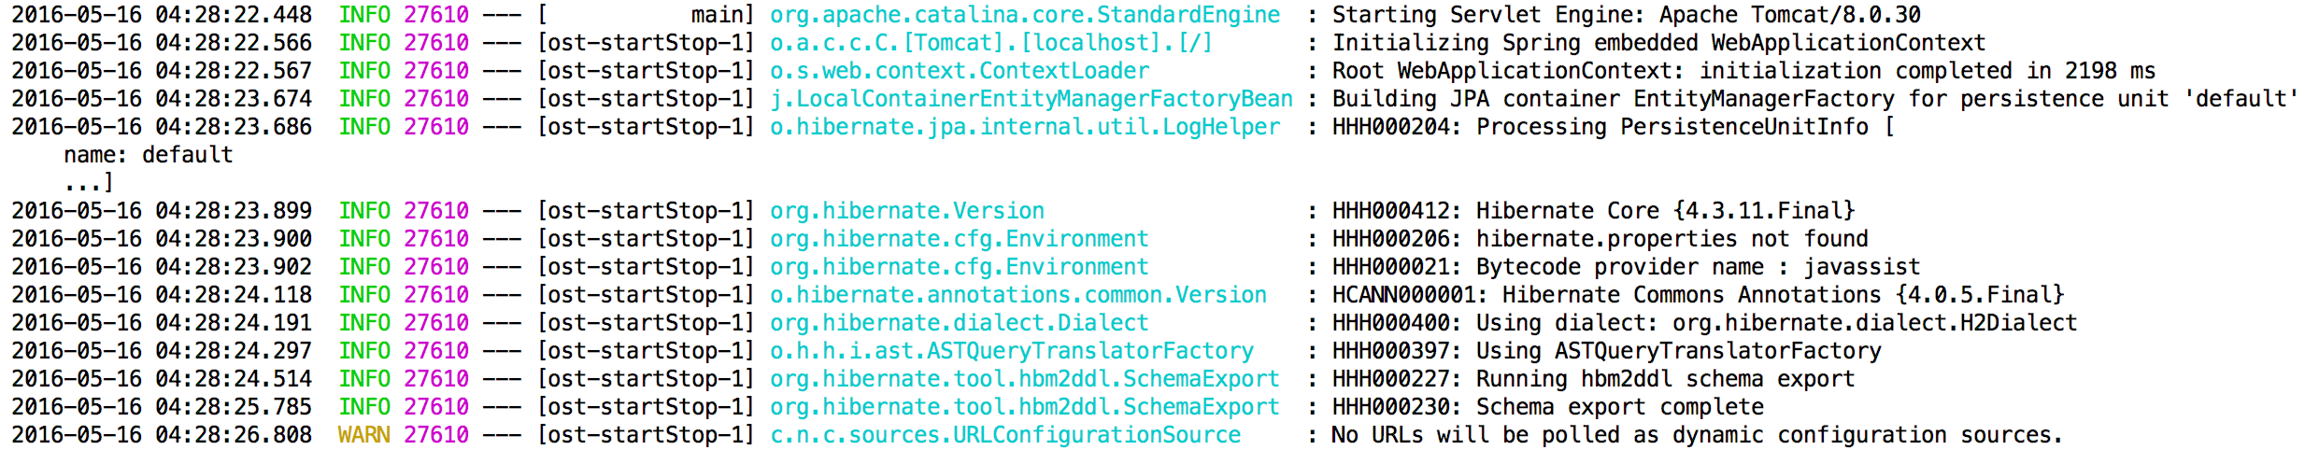
Auto-Configuration
Automatically configure your Spring application based on the JAR dependencies that have been added
Quickly create new microservices with little configuration
Still have the ability to customize the application
Notes:
For example, if HSQLDB is on your classpath, and you have not manually configured any database connection beans, then Spring Boot will auto-configure an in-memory database

Slide 5
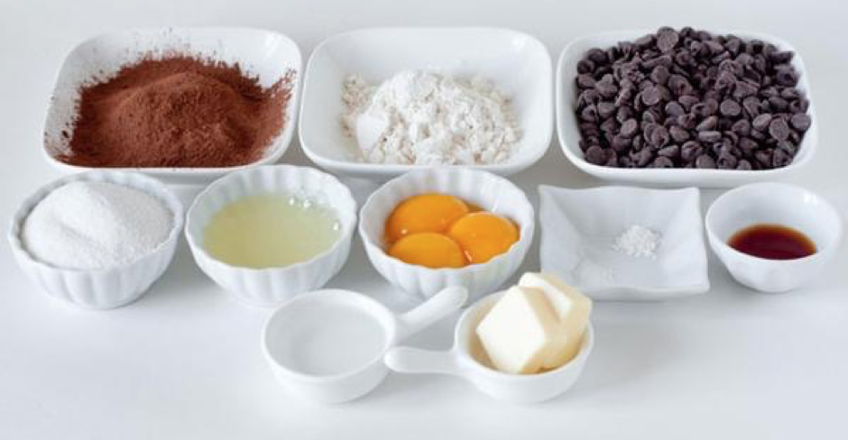
Packaging of Applications

Slide 6

Packaging of Applications

Slide 7
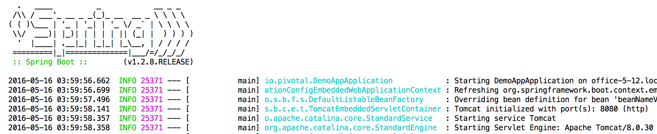
Instant App Server, Database, Messaging
Selects defaults and runs them for you
Immediately get application server injected
Same goes for;
Database
Messaging Queues
etc....
Notes:
In this case here we can see Tomcat is injected, initialized and started

Slide 8

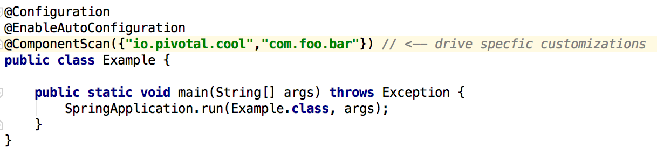
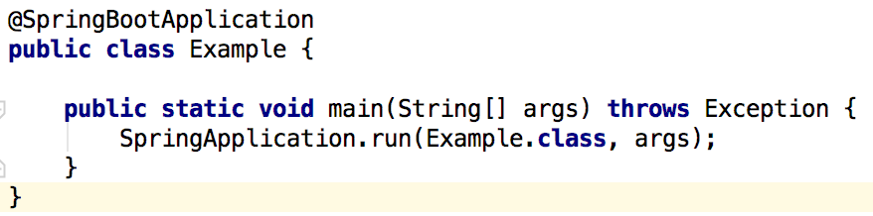
Spring Boot, In the Wild
Tells Spring Boot to start adding beans based on class path settings, other beans, and various property settings
Tells Spring Boot by convention how Spring should be configured based on classpath dependencies
Notes:
@Configuration + @EnableAutoConfiguration (optionally + @ComponentScan)
vs.
@SpringBootConfiguration
They are equivalently the same (@ComponentScan is optional and allows you the developer to customize which bean are loaded from the classpath)

Slide 9
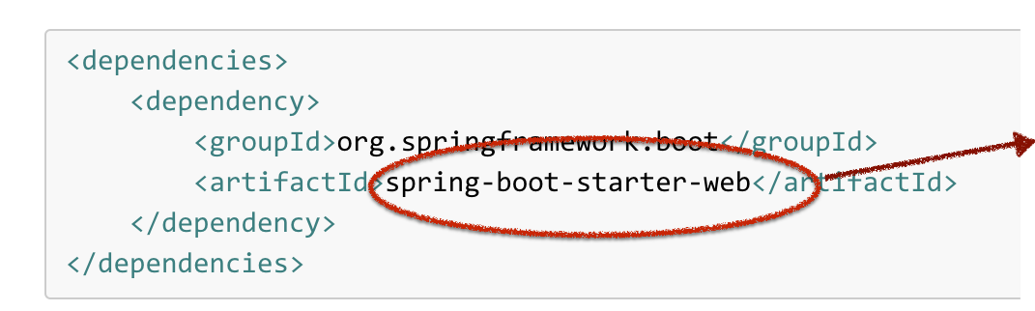
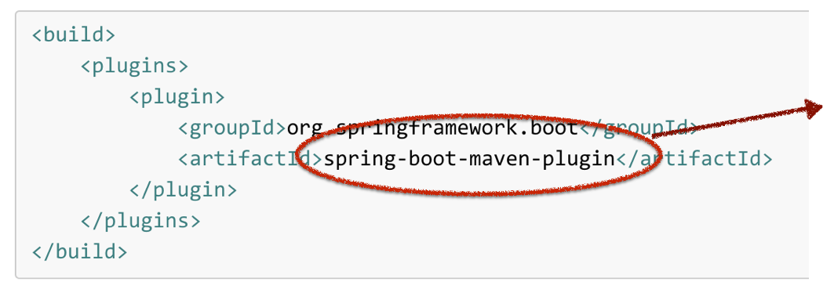
How does it work? Create a Web App
Use Maven Starter POM
Automatically creates a dependency on Spring Boot and Tomcat application server
Make an Executable JAR
Create a Spring Boot executable JAR that contains:
Code to run
Spring Boot Loader classes
Dependency libraries

Slide 10
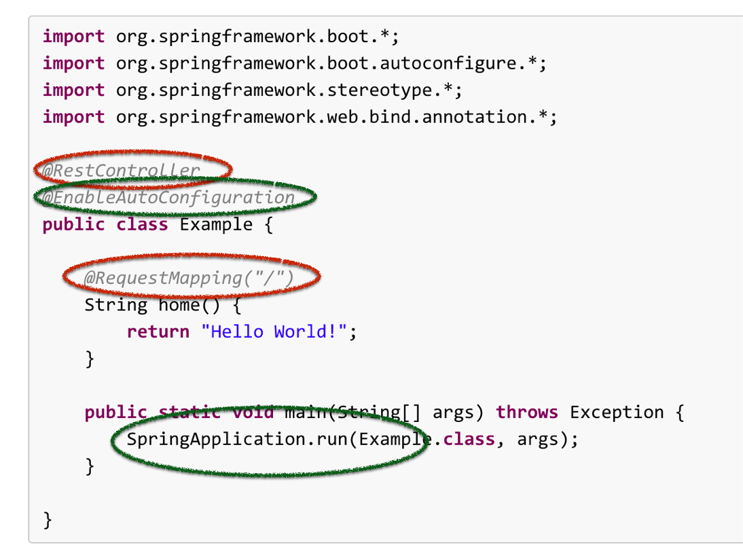




Spring Boot, an example
Tells Spring Boot by convention how Spring should be configured based on classpath dependencies
Spring REST annotation, it tells Spring this is a ‘Controller’ and that any HTTP request to context ‘/’ should be directed to the home method
Delegates to Spring Boots’ SpringApplication to bootstrap the application
Notes:
The key to the Spring Boot’s auto-configuration magic is @EnableAutoConfiguration annotation. Typically we annotate our application entry point with either @SpringBootApplication or if we want to customize the defaults we can use annotations @Configuration, @EnableAutoConfiguration or @ComponentScan
The @EnableAutoConfiguration annotation enables the auto-configuration of Spring ApplicationContext by scanning the classpath components and registers the beans that are matching various Conditions.
SpringBoot provides various AutoConfiguration classes in spring-boot-autoconfigure-{version}.jar which are responsible for registering various components.
Typically AutoConfiguration classes are annotated with @Configuration to mark it as a Spring configuration class and annotated with @EnableConfigurationProperties to bind the customization properties and one or more Conditional bean registration methods.

Slide 11

Spring Boot, an example
Notes:
The key to the Spring Boot’s auto-configuration magic is @EnableAutoConfiguration annotation. Typically we annotate our application entry point with either @SpringBootApplication or if we want to customize the defaults we can use annotations @Configuration, @EnableAutoConfiguration or @ComponentScan
The @EnableAutoConfiguration annotation enables the auto-configuration of Spring ApplicationContext by scanning the classpath components and registers the beans that are matching various Conditions.
SpringBoot provides various AutoConfiguration classes in spring-boot-autoconfigure-{version}.jar which are responsible for registering various components.
Typically AutoConfiguration classes are annotated with @Configuration to mark it as a Spring configuration class and annotated with @EnableConfigurationProperties to bind the customization properties and one or more Conditional bean registration methods.

Slide 12

Lab

